Slide 1


Python Final Project: Nashville Traffic Accident Data Analysis

Slide 2
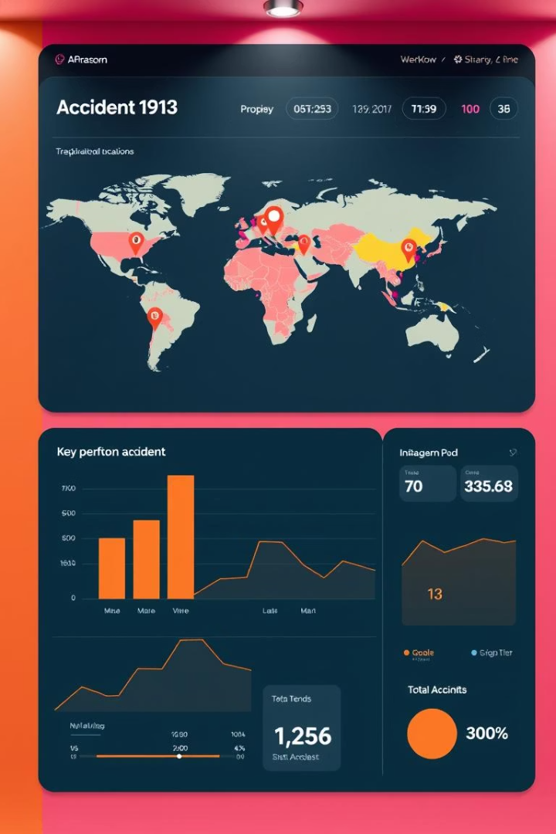
Abstract
Analyzed 1M+ Nashville traffic records (2018–2024)
Python EDA revealed risk patterns
15 charts exposing crash timing, severity, locations
Policy recommendations and future extensions

Slide 3
Agenda
Introduction
Dataset Overview
Preprocessing
Literature Review
Methodology
Results (Charts)
Key Insights
Recommendations
Future Scope
References

Slide 4

Introduction
Traffic Effects
Context
Costs lives and resources
Nashville's rapid growth demands smarter insights
Goal
Uncover accident patterns using data science

Slide 5
Dataset Overview
Source & Time
Key Fields
Nashville Open Data Portal, Jan 2018 – Apr 2024 (~1M records)
Date & Time
Collision Type
Weather Conditions
Location Coordinates
Injuries Count

Slide 6

Preprocessing
Data Cleaning
Dropped rows with null essential fields
Feature Engineering
Extracted Hour, Weekday, Month from timestamps
Data Refinement
Grouped collision types; filtered erroneous GPS data
Injury Calculation
Computed total injuries per accident record

Slide 7
Literature Review
Commute Risks
Weather Paradox
Severe Conditions
Spatial Analysis
High crash probability during commute times
More crashes under clear weather despite good conditions
Fog and snow cause fewer but more severe crashes
Geospatial clustering effectively identifies hotspots

Slide 8
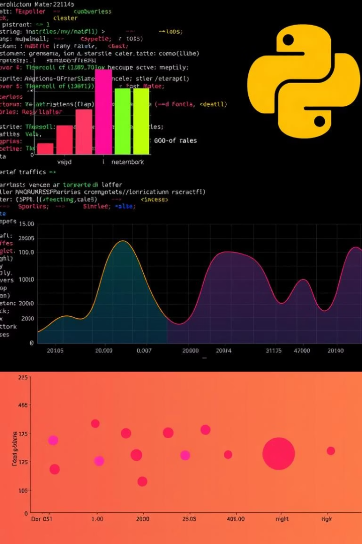
Methodology
Tools
Python, Pandas, Seaborn, Matplotlib
Process
Load → Clean → Feature Engineer → Chart → Summarize
Charts
Produced 15 charts across time, location, severity, type

Slide 9

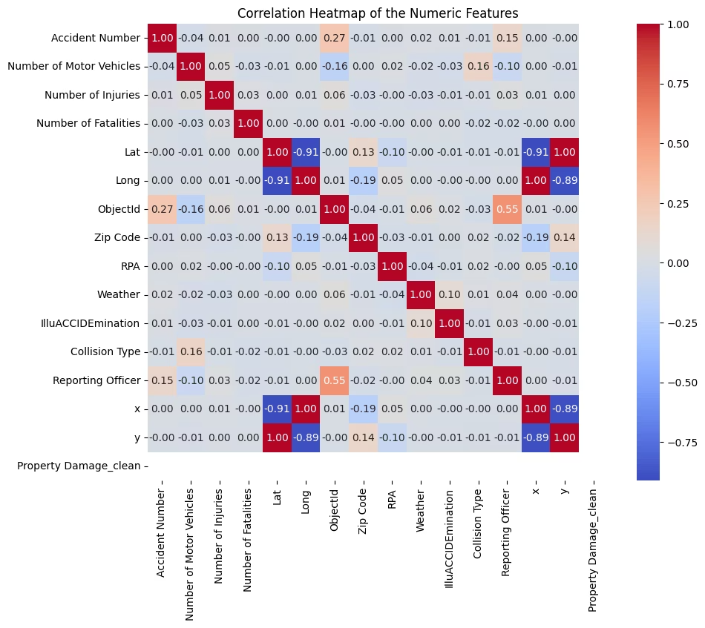
Correlation Heatmap of Numeric Features
This heatmap highlights correlations among numeric features.
Number of vehicles shows the strongest link to injuries.
Fatalities have weaker, less clear correlation patterns.
Insights guide feature selection for predictive modeling.

Slide 10
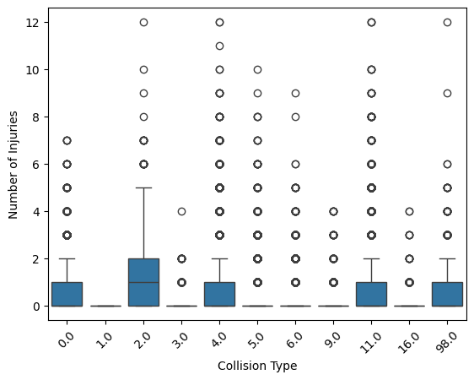
Boxplot – Injuries by Collision Type
Rear-End and Head-On Collisions
Sideswipes and Parking Collisions
Wider injury variability, indicating higher severity risk.
Generally result in fewer injuries and less severity.

Slide 11

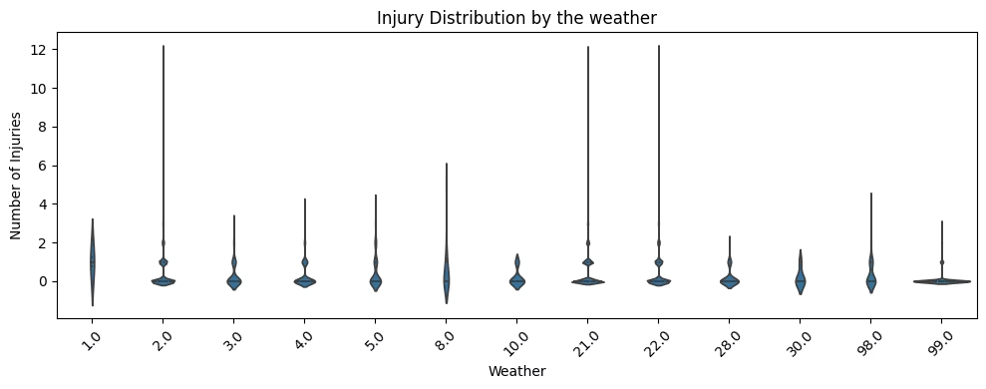
Violin Plot – Injury Distribution by Weather
Fog, Snow, and Rain
Clear Weather
Higher injury variability and elevated injury counts.
Steady, lower injury ranges, indicating safer conditions.

Slide 12
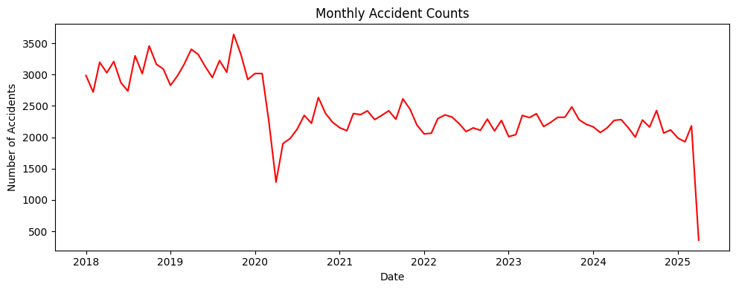
Line Plot – Monthly Accident Counts
Seasonal Trends
Winter months, especially Dec-Jan, show increased crashes.
COVID-19 Impact
Accident counts declined notably during lockdowns.

Slide 13

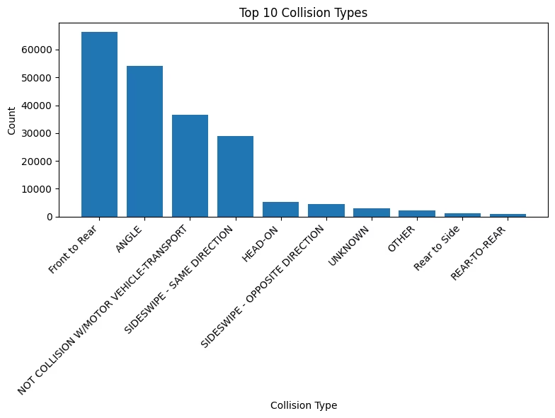
Bar Chart – Top 10 Collision Types
Rear-End
Most frequent collision type.
Angle
Second most common crash category.
Sideswipe
Also prevalent in accident records.
Others
Remaining seven types collectively contribute to majority.

Slide 14

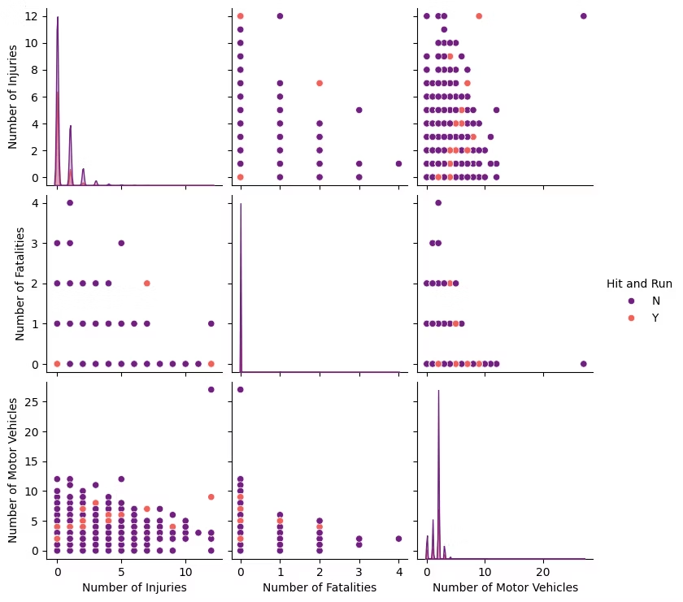
Pairplot – Severity Patterns (Injuries, Fatalities, Vehicles)
Clusters
Low injury/vehicle cases group together, showing common outcomes.
Isolated High Severity Events
High injury-fatality crashes often relate to hit-and-run scenarios.

Slide 15

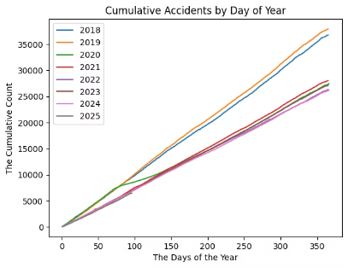
Line Chart – Cumulative Accidents by Day of Year
Consistent Yearly Patterns
Forecasting Use
Accidents accumulate similarly each year, peaking mid-year.
Supports long-term seasonal crash risk prediction.

Slide 16

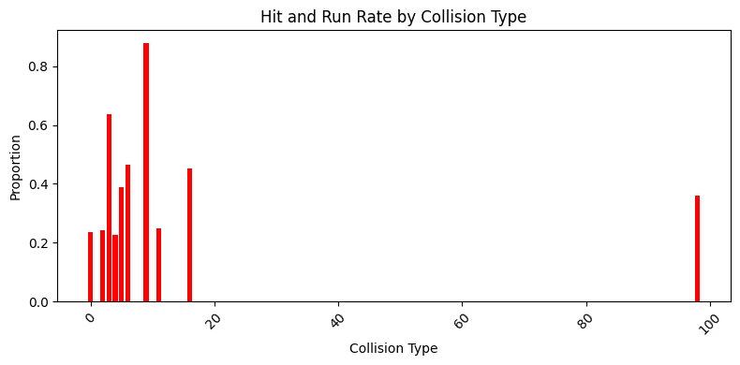
Bar Chart – Hit-and-Run Rate by Collision Type
Sideswipe and Rear-End Collisions
Highest association with fleeing drivers in hit-and-run incidents.
Law Enforcement
Data can guide enforcement focus to reduce hit-and-run rates.

Slide 17
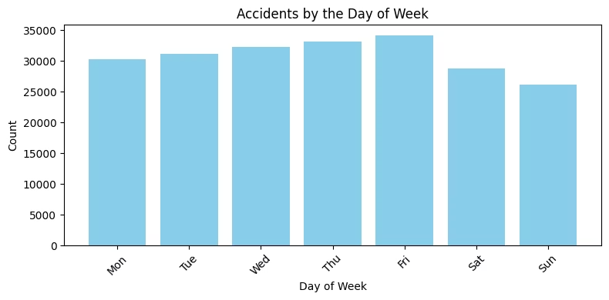

Bar Chart – Accidents by Day of Week
Peak Days
Lowest Day
Friday and Saturday have the highest accident volumes.
Sunday records the fewest crashes, suggesting lighter traffic.
Implications
Weekend traffic policies could focus on high-risk days.

Slide 18
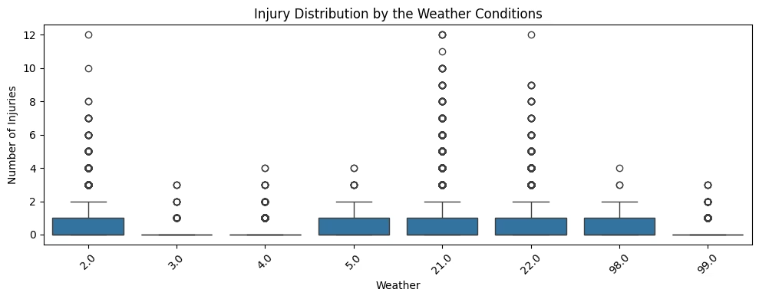
Boxplot – Injuries by Weather (Top 8 Conditions)
Foggy and Snowy Weather
Lead to wider injury value spread and higher risk.
Weather Alerts
Highlight importance of alert systems during severe conditions.

Slide 19
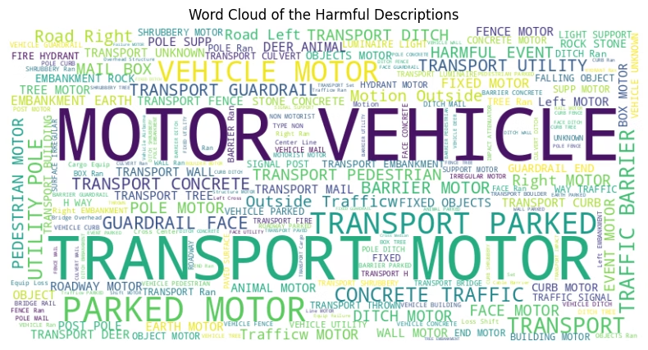
Word Cloud – Harmful Descriptions
Text-based visualization reveals common injury causes in crashes.
Frequent phrases include rear-end, intersection, and failure to yield.
This aids labeling and NLP pattern identification in traffic safety data.

Slide 20
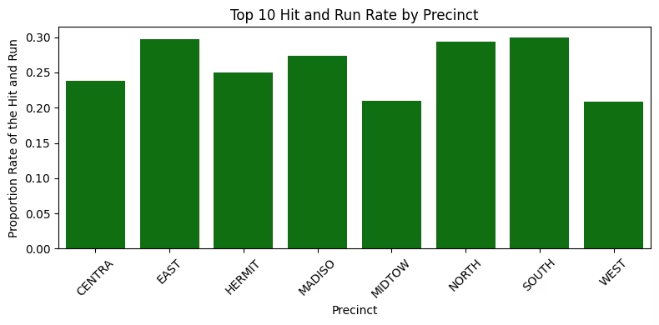
Bar Chart – Top 10 Precincts by Accident Count
Key Findings
Implications
Resource allocation can focus on high-risk precincts for prevention.
Downtown Nashville leads in accident count
Major intersections are frequent crash sites
Data supports targeted safety interventions

Slide 21
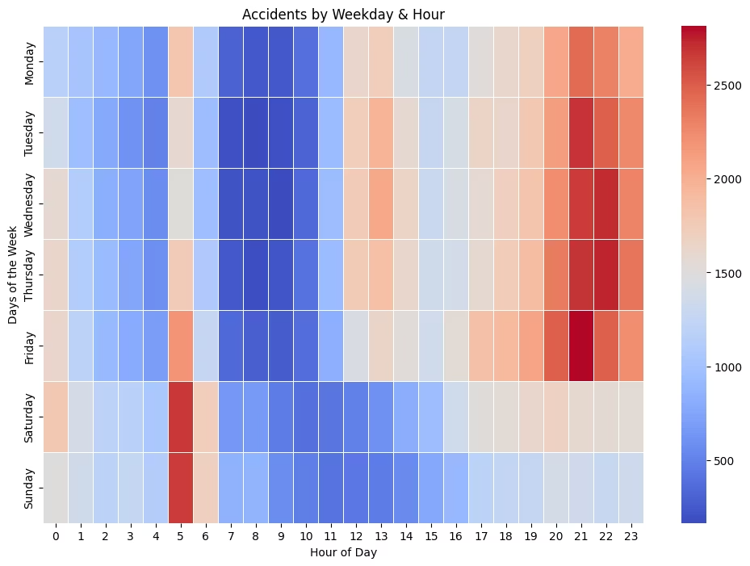
Line Chart – Collision Count Over Time
Peak Times
Evenings 5-9 PM have the most crashes on weekdays.
Weekday Trends
Friday peaks near 9 PM, indicating heightened risk.
Weekend Patterns
Crashes spread over early mornings and late nights on Saturdays and Sundays.

Slide 22
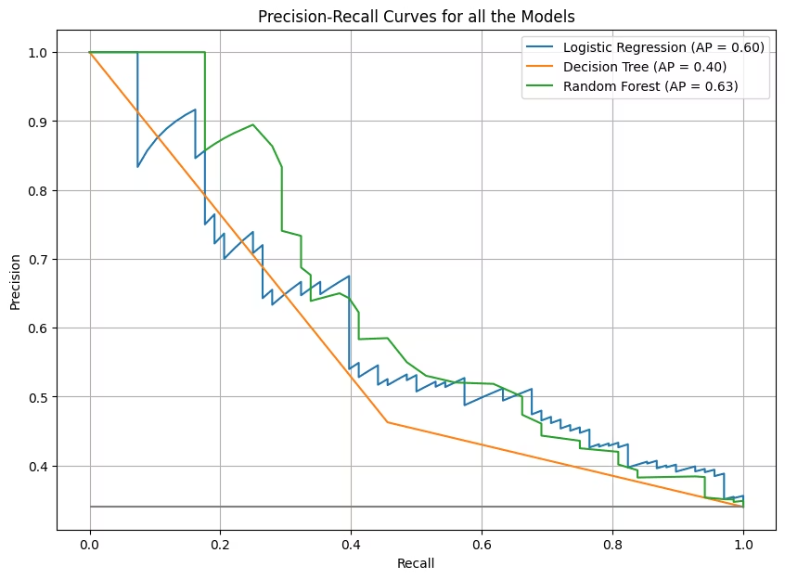
Precision-Recall Curve for Model Comparison
Logistic Regression
Baseline performance for comparison
Decision Tree
Moderate precision and recall balance
Random Forest
Best performer with Average Precision (AP) = 0.63

Slide 23
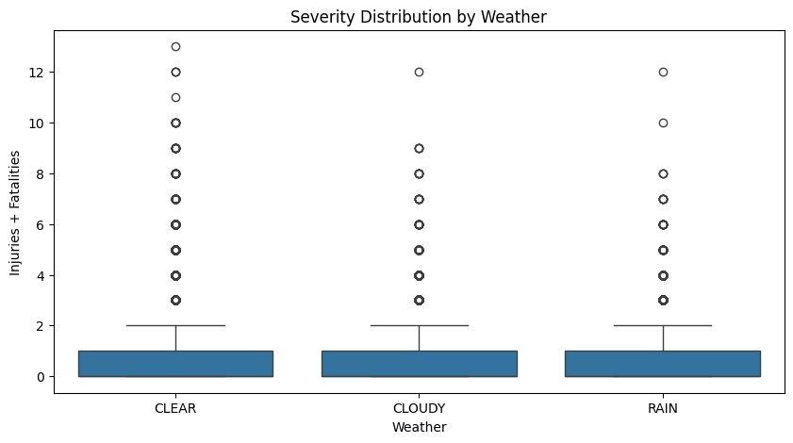
Severity Distribution by Weather
Observations
Real-World Impact
Clear weather has highest accident frequency
Understanding environmental factors improves public safety.
Weather impacts injury and fatality severity
Key for informing traffic safety policies

Slide 24

Key Insights
Dominant Crash Types
Weather Influence
Clear weather leads to high accident counts.
Rear-end and angle collisions are most frequent.
Risk Periods
Weekends and peak commute hours are most dangerous.

Slide 25

Recommendations for Safety Improvements
Deploy Patrols
Focus on 7–9 AM and 4–7 PM peak hours.
Install Cameras
Equip top 10 accident hotspots with surveillance.
Increase Awareness
Educate drivers on risks in good weather conditions.

Slide 26




Future Scope in Data Science
Risk Prediction
Train machine learning models to forecast accidents.
API Integration
Combine weather and traffic data for robust analysis.
Interactive Dashboards
Use Folium and Leaflet for spatial crash data visualization.

Slide 27

References
Nashville Open Data Portal: primary data source
Python libraries: Pandas, Seaborn, Matplotlib for analysis
NSS Blog and GitHub Crash Projects: additional research

Slide 28

GitHub Repository & QR Code
Access full notebook, code, and visualizations here:
Scan the QR code to explore the project instantly.

